Slide 1


Session 2021-22
Java Project
Employee Management System
Submitted By:
Bhavini jain
Jai Kanthalia
Harshit Chaubisa

Slide 2


OBJECTIVE OF THE PROJECT
In this world of growing technologies everything has been computerized. With large number of work opportunities the Human workforce has increased. Thus there is a need of a system which can handle the data of such a large number of Employees in an organization. This project simplifies the task of maintain records because of its user friendly nature.

Slide 3


About Employee Management System
A
It is distributed application, developed to maintain the details of employee working in an organisation.
B
It has been developed to override the problems prevailing in the practicing manual system
C
It maintains information about the personal and official details of the employee.
D
Through this the admin can send mails to the respective employees about their task and information or updates.
E
In this we can make groups according to their post in the company for easy maintanance.

Slide 4

About Java Swing
Highly Customizable
Components are lightweighted
More Components:
Tables,
Lists,Buttons,Frames, Labels etc...
Platform Independent
Pluggable look
MVC
Model View Controller

Slide 5
ADMIN
Admin logins by its user password.
Tasks
Admin performs all task and updation.
Results
Improved Management

Slide 6
Employee Management
04
03
Send Mail
Groups
Send email to employees.
Creating groups of different posts.
01
05
Login Page
02
Login by entering username and password.
View Groups
Main Page
View all employess in the company.
Options of the application
ADD, View, Remove, Update

Slide 7
Main Page
Tasks of Admin that he/she can perform :
ADD
Employee
VIEW
Employee
UPDATE
Employee
REMOVE
Employee
Add New Employee
Print the Details
Upadating Details
Remove employee
Add new employee by entering all its details.
Search ,Print and veiw the detils of employee added.
Make changes in details entered.
Remove the employee permanently.

Slide 8
Groups Management
Employees are grouped in the respective groups according their post.
Team_Leader
Project Manager
Senior Engineer
Junior Engineer
Others
Group

Slide 9
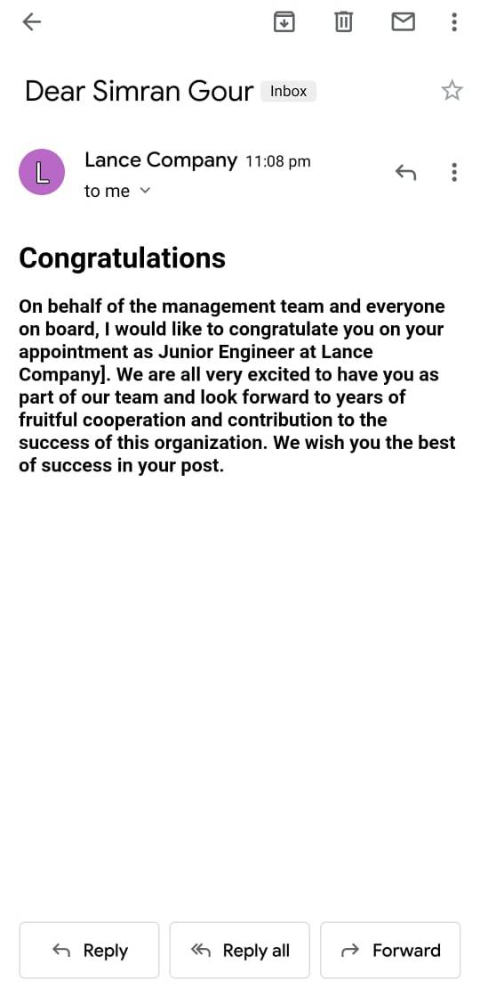
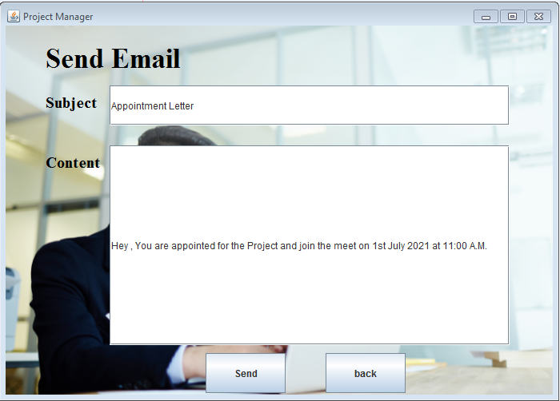
Sending Information through email
Send Mail
Admin can send important notice, updates ,ting schedules and other information by sending the mail to all the group members of the respective groups about there task or the notices.
A congratulation mail is send to all the employees who newly got added in the organization.

Slide 10
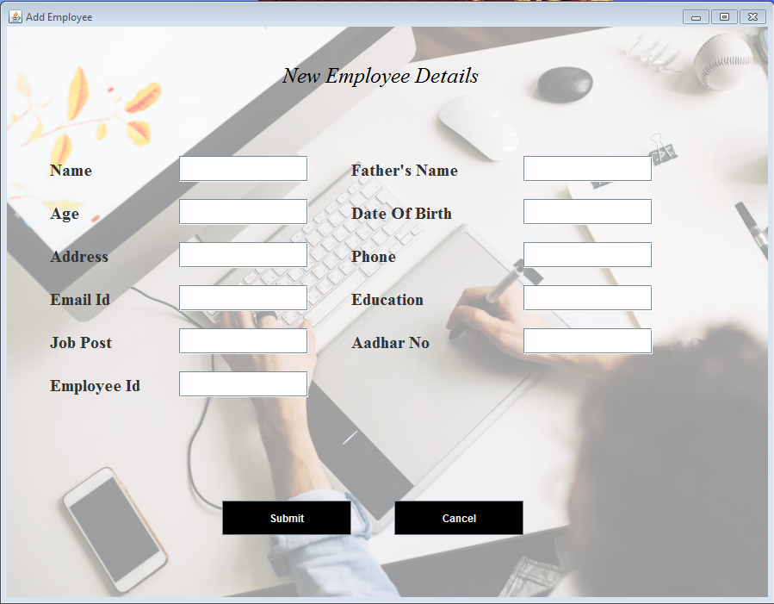
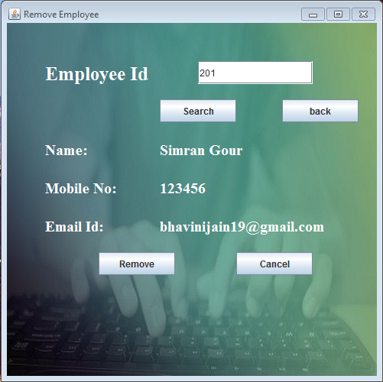
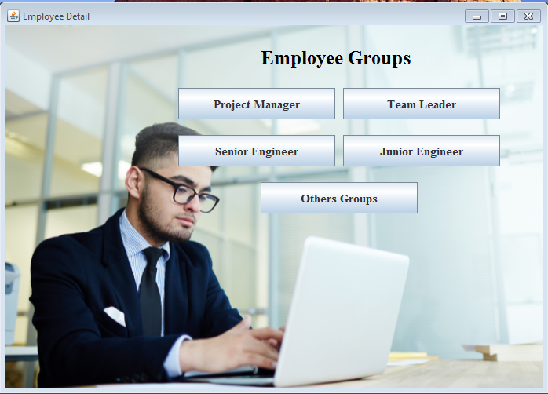
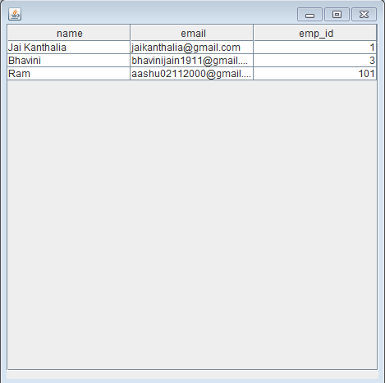
EMS
EMS
Add Employee details and search employee by its ID.
EMS GROUPS
Grouping employee in their respective groups and can view them in the table

Slide 11


Future Works
Implement Client Side
We can add client slide making interafce for employees with some roles for managing.
Implement Salary Management
We can add employees’bank details and can manage their montly salary through this system.

Slide 12
Benifits of EMS
01
Efficiency And Better Accuracy
02
Fewer Compliance Risks
08
Ensure COMPLIANCE
1
2
03
Boosted Profitability
8
3
7
4
07
Lower Costs
04
Very Few Manual Errors
6
5
06
Higher Motivation
05
Higher Productivity

Slide 13

THANK YOU!

